Slide 1
Msd24png1

Slide 2
github
BRANCHES
COMITS
PUSH REQUESTS
PULL REQUEST
COMMUNICATION METHOD – WHATSAPP

Slide 3
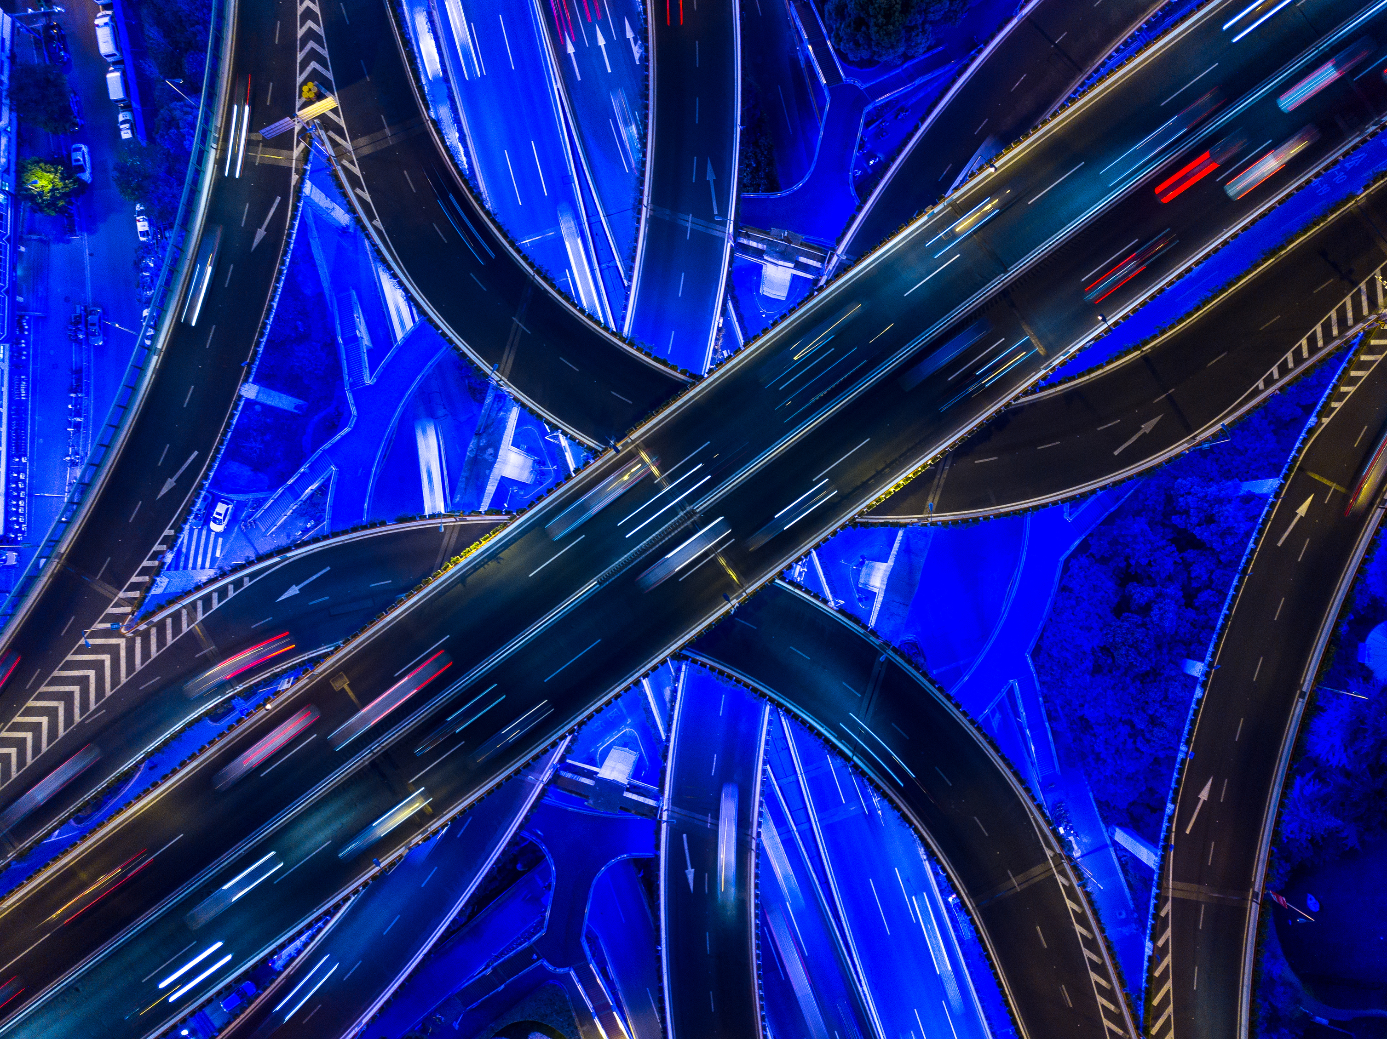
Github desktop

Slide 4

Main branch​
All sub-branches sent in the work.
Jeri Branch
Isaac Branch
Virginia Branch
Kathryna Branch

Slide 5
THANK YOU
Done by:
JERICHA TOLOPA
KATHRYNA TURI
ISAAC JACOB
VIRGINIA WHEMBY

